Slide 1

Final Project Demonstration
Kazi Md Nazmul Hoque
ID: 30059
Project Name
Training Management System (TMS)

Slide 2
Technology Stack
Backend:
Spring Boot
Spring Security
Jwt Token
Rest Architechture
JPA, Lombok
Hibernate ORM
Multipart Rest
Frontend:
React Js
React Router, React Hooks, React Events
Redux state management
Fetch

Slide 3
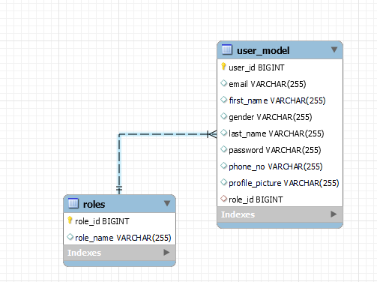
Product Perspective & User Details
Overall system was developed by keeping in mind that this project this closed for modification and open for extension.
Structure of the system:
Users have single role
( Trainee, Trainer, Admin )

Slide 4
Modules Covered
Trainee/Trainer Registration
User Management
Schedule management
Classroom management
Course Management
Batch Management
Assignment and submit answer

Slide 5
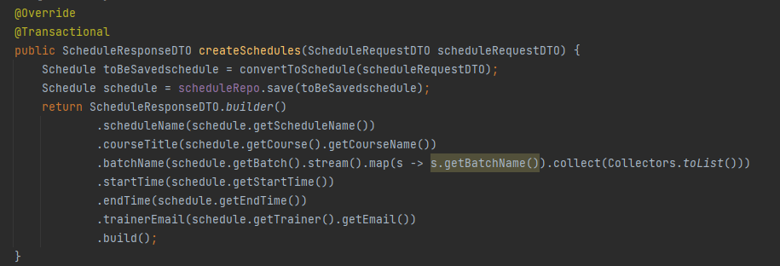
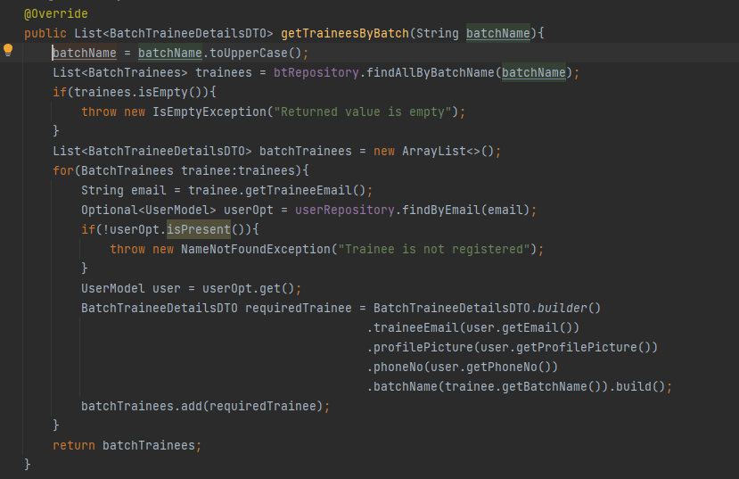
Topics Covered:
Lambda Expressions, foreach, stream

Slide 6
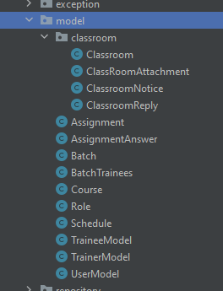

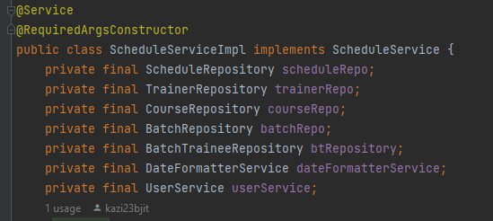
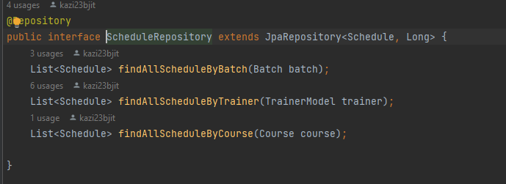
Topics Covered:
DAO, Dependency Injection (DI), utility services

Slide 7
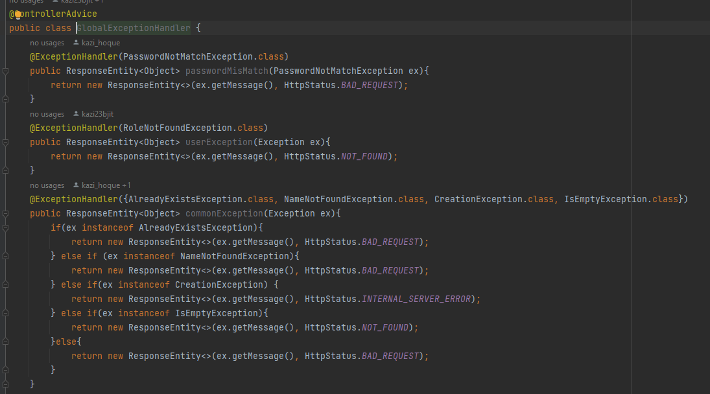
Topics Covered:
Exception Handling with Annotations

Slide 8
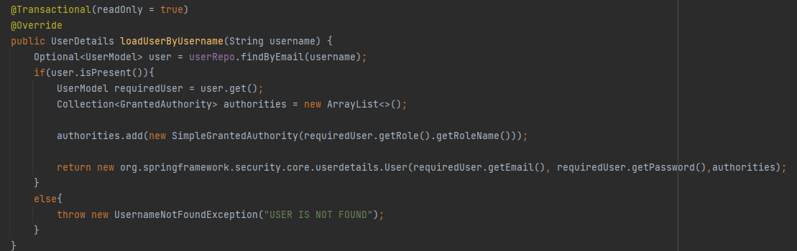
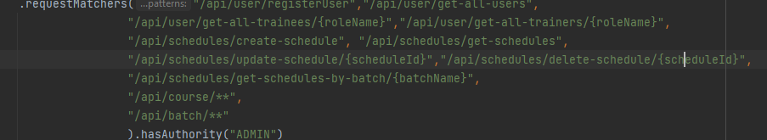
Topics Covered:
Spring Security

Slide 9
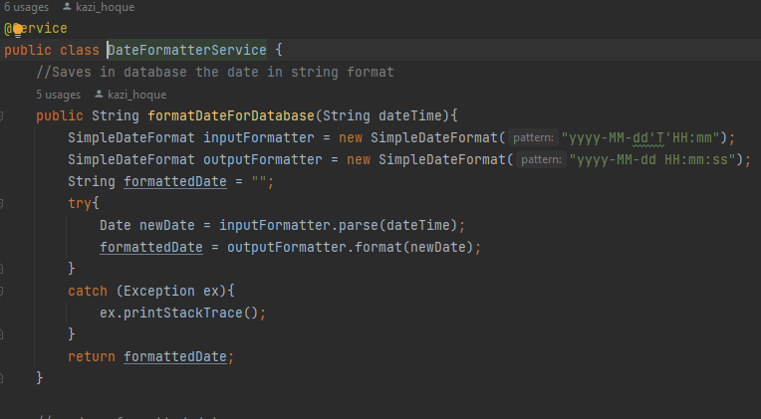
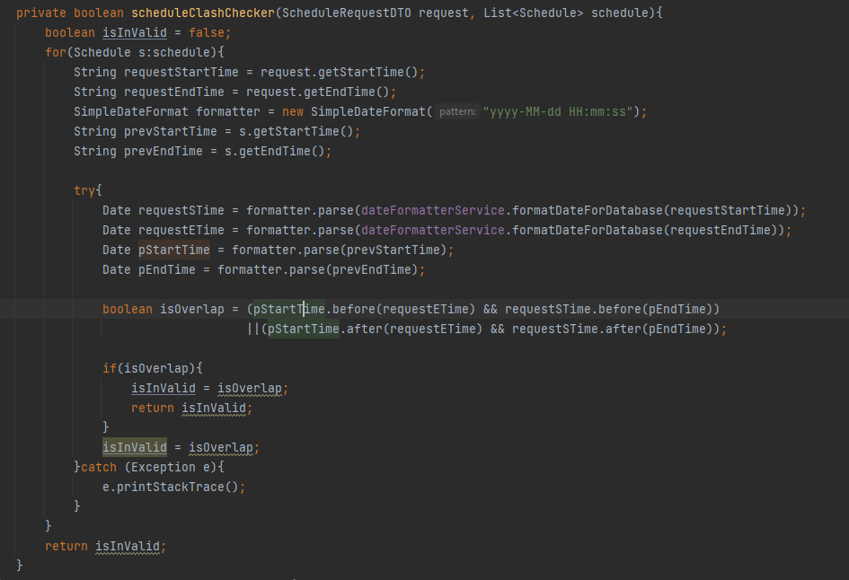
Topics Covered:
Custom utility class and functions

Slide 10
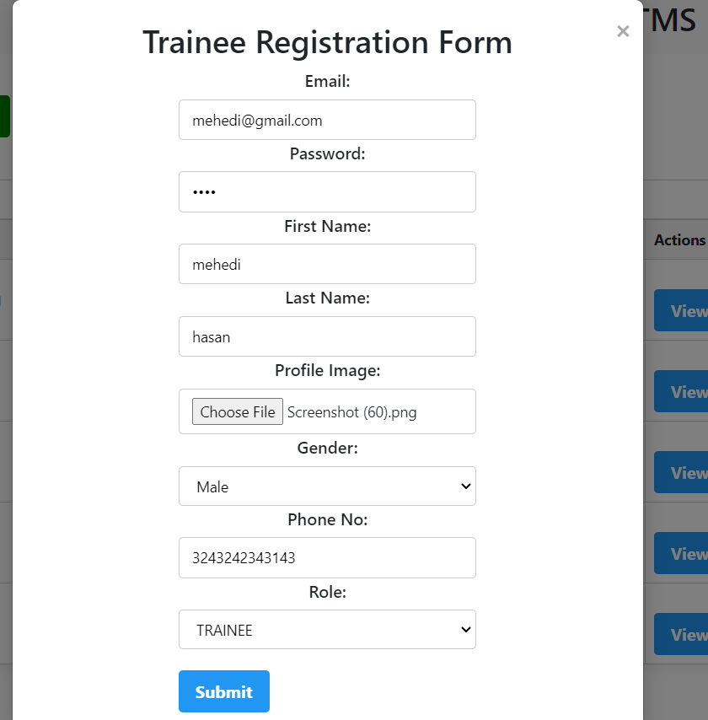

Slide 11
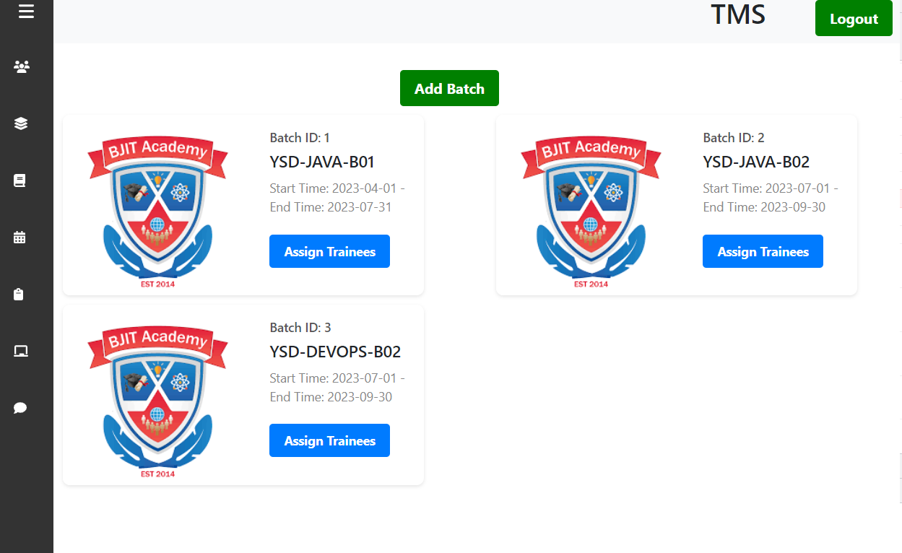
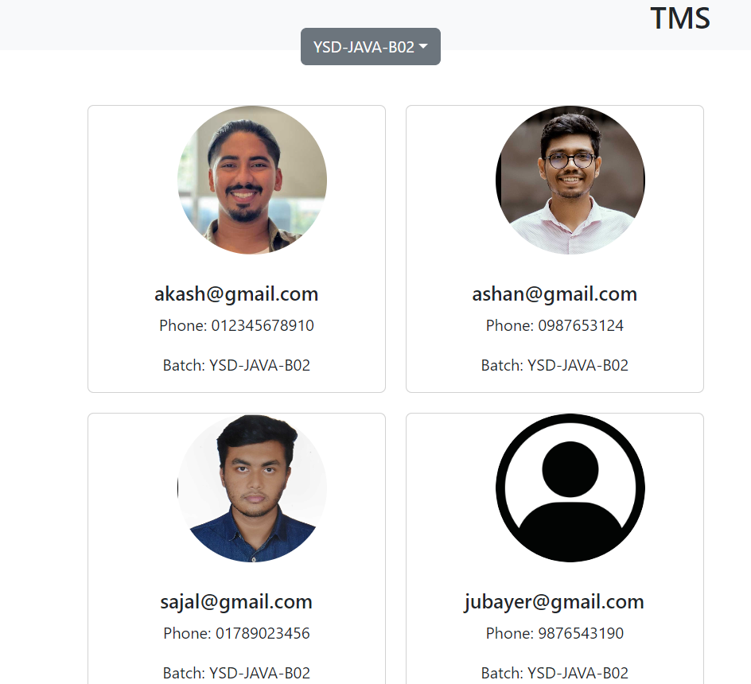

Slide 12
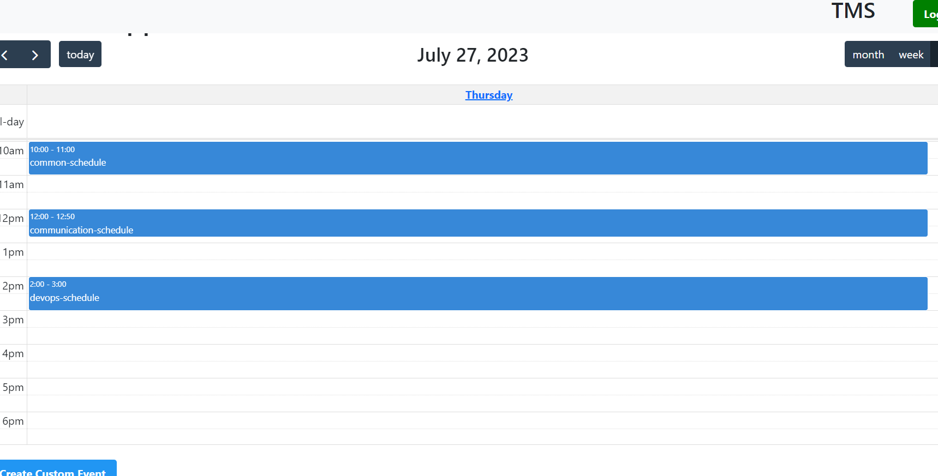

Slide 13
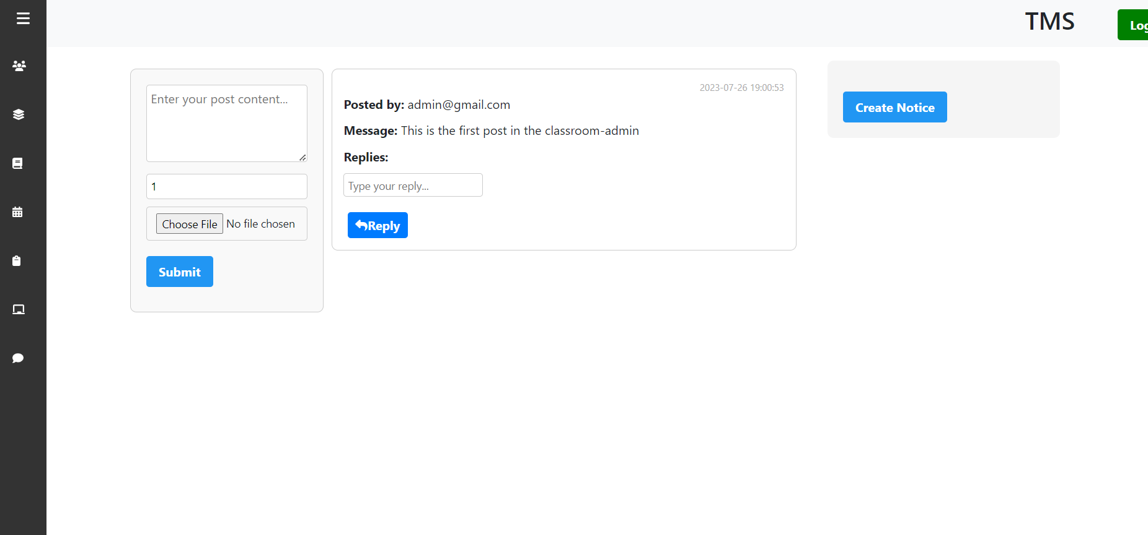

Slide 14
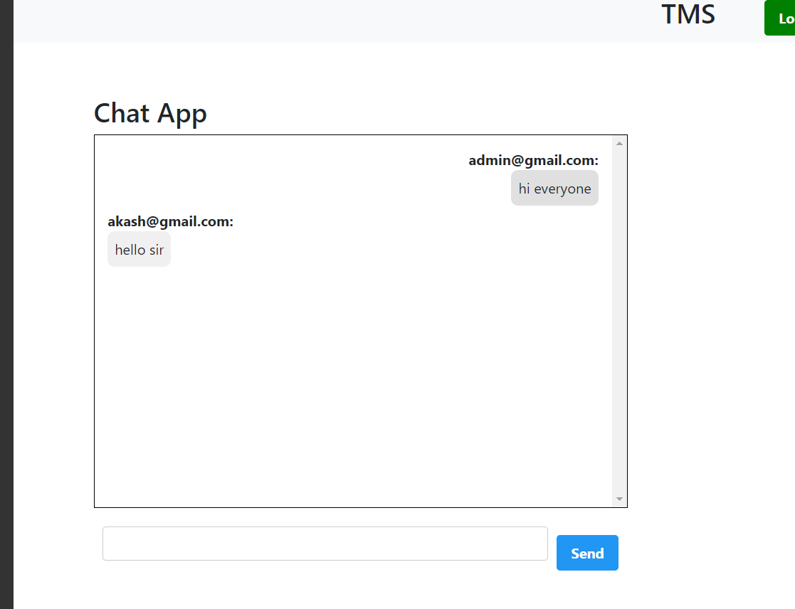

Slide 15
Future Enhancements
Make the schedules dynamic to show the schedules of the current batches according to the training period months.
Create group chat, private message functionality with file sharing options.
Implement a Builder design pattern to provide common building functionality of different modules.
Implement HTTP only cookie for authentication.
Provide more dynamic view to the classroom.

Slide 16
Conclusion
Thank You

